Slide 1
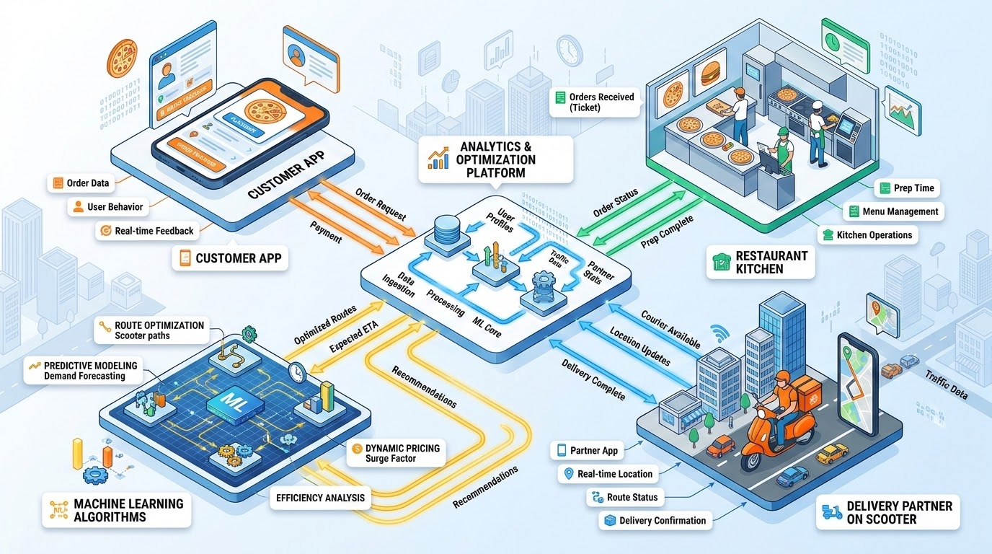
OI
UBER EATS INTEL
Uber Eats –
Operational Intelligence
End-to-End Data Analytics and Machine Learning Solution
Presented by: B. Sai Neha Eshwari
Project Duration: 7 Days

Slide 2
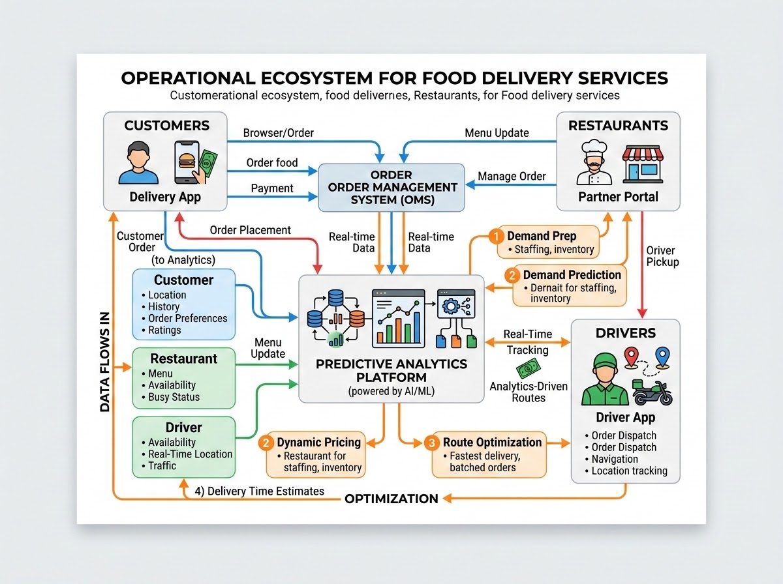
Understanding the Business Problem
OI
UBER EATS
Core Objective: Leverage data analytics and machine learning to resolve core operational challenges, understand operational patterns, evaluate predictive models, and generate actionable business insights.
Operational Challenges:
Understanding customer ordering behavior
Identifying restaurant performance patterns
Evaluating customer satisfaction
Predicting delivery times
Forecasting hourly order demand
Analyzing tipping patterns
Pinpointing high-activity locations and time periods
Resolving these challenges will directly lead to better operational decision-making.

Slide 3
Understanding the Datasets
OI
UBER EATS
Customers: Contains 500 records including age and city.
Orders: Has 3,000 records tracking timestamps and amounts.
Payments: Includes tip amounts and payment methods (3,000 records).
Deliveries: Monitors distance, weather, and traffic (3,000 records).
Reviews: Captures text and sentiment (3,000 records).
Restaurants: Tracks performance and operational attributes for segmentation.

Slide 4
Data Cleaning and Preparation
OI
UBER EATS
ETL Pipeline Overview: Transforms raw multi-source data through structured cleaning, feature engineering, and encoding into a model-ready integrated dataset.
01. RAW DATA
Ingestion
• Raw data inspection
• Merging tables via key IDs
02. INSPECT
Validation
• Data type casting
• Schema verification
03. CLEANING
Imputation
• Handling missing values
• Zero duplicate rows
04. FEATURE ENG.
Scaling
• Feature scaling for clustering
• Numeric normalization
05. TRANSFORM
Encoding
• Text prep for NLP
• Timestamp encoding
06. MODEL-READY
Final Output
• Integrated dataset
• Complete by Day 6
INTEGRATED DATASET SIZE
TOTAL FEATURE COLUMNS
DUPLICATE ROWS VERIFIED
3,000
26
0
Clean, model-ready records
Engineered & transformed variables
Zero redundancy milestone by Day 6

Slide 5
Unsupervised Machine Learning – Segmentation
OI
UBER EATS
Objective: Apply unsupervised learning to segment customers (total orders, frequency, spending, AOV, late-night habits) and restaurants (performance and operational attributes) to identify distinct behavioral groups.
K-Means Clustering
DBSCAN Clustering
Centroid-based algorithmic approach for spherical cluster identification across high-dimensional feature spaces.
Cluster Optimization: Utilizes the Elbow Method to evaluate inertia and determine optimal predefined cluster counts (k).
Customer Metrics: Segments profiles using total order volume, order frequency, total spending, and average order value (AOV).
Restaurant Grouping: Groups venues according to operational efficiency, fulfillment rates, and performance tiers.
Density-based spatial clustering technique designed to uncover arbitrary shapes and eliminate outliers.
Parameter Flexibility: Operates on spatial density, eliminating the requirement for predefined cluster counts.
Noise Detection: Effectively isolates extreme behavioral anomalies, irregular late-night order spikes, and outlier operational attributes.
Behavioral Discovery: Uncovers continuous, non-linear patterns in customer spending and restaurant usage habits.

Slide 6
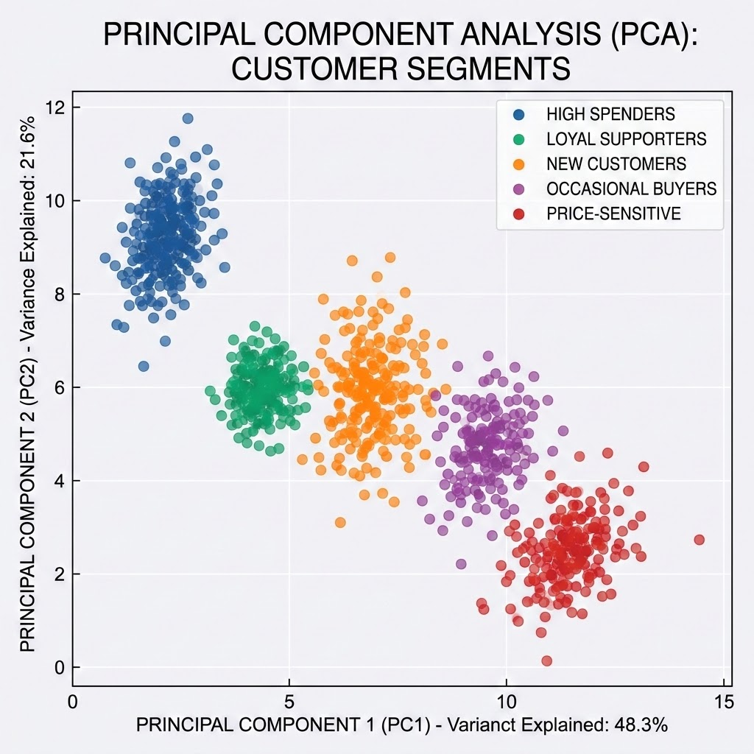
Visualizing and Understanding Clusters
OI
UBER EATS
Principal Component Analysis (PCA) is utilized for dimensionality reduction, allowing us to project high-dimensional customer and restaurant data into a 2D visual space.
Customer Segments: Interpreting these clusters helps us identify high-value customer segments and distinct engagement patterns.
Restaurant Targets: For restaurants, this visualization highlights specific operational intervention targets.
Cluster Validation: Silhouette scores and detailed profile metrics are used to validate the distinctness and business value of each cluster.

Slide 7
Natural Language Processing – Customer Feedback Analysis
OI
UBER EATS
We analyze 3,000 customer reviews to understand sentiment and uncover drivers of satisfaction and recurring complaints.
NLP WORKFLOW PIPELINE
Text Preprocessing: Cleaning, normalization, tokenization, and TF-IDF vectorization.
Model Evaluation: Benchmarked Naive Bayes, Support Vector Machine (SVM), and VADER sentiment analysis.
Key Insight: Clear sentiment distribution provides a structured view of overall service performance.
SENTIMENT DISTRIBUTION (N=3,000)
1,766
779
455
POSITIVE
NEGATIVE
NEUTRAL

Slide 8
Sentiment Evaluation and Customer Experience Insights
OI
UBER EATS
MODEL EVALUATION PERFORMANCE
1.00 Accuracy
Both Naive Bayes and SVM models reported a perfect 1.00 accuracy on their evaluation sets.
BUSINESS RELEVANCE & VALIDATION NOTES
Model Evaluation Caution:
These perfect classification scores require cautious interpretation and must be independently validated on unseen real-world test data.
Strategic Operations Relevance:
Categorizing complaints highlights frequent service pain points, allowing operations to address recurring complaints and prioritize targeted customer experience interventions.

Slide 9
Supervised Machine Learning – Delivery Time Prediction
OI
UBER EATS
Evaluated multiple models to estimate delivery duration using operational factors (distance, weather, traffic). Linear and Ridge Regression emerged as top performers.
LINEAR & RIDGE REGRESSION (TIED TOP PERFORMERS)
LASSO REGRESSION
MAE: 20.48 | RMSE: 23.67 | R²: 0.0007
Linear and Ridge Regression effectively tied as the highest-performing models for estimating delivery duration based on operational features.
MAE: 20.49
Followed closely behind the top performers, demonstrating comparable predictive stability with slight L1 regularization penalty.
GRADIENT BOOSTING
RANDOM FOREST
MAE: 20.79 | R²: -0.0366
Performed worse than linear baselines, resulting in a negative R² score indicating poor generalization on this specific feature set.
MAE: 22.29 | R²: -0.2841
Underperformed significantly compared to linear models, exhibiting substantial overfitting and the lowest R² value overall.

Slide 10
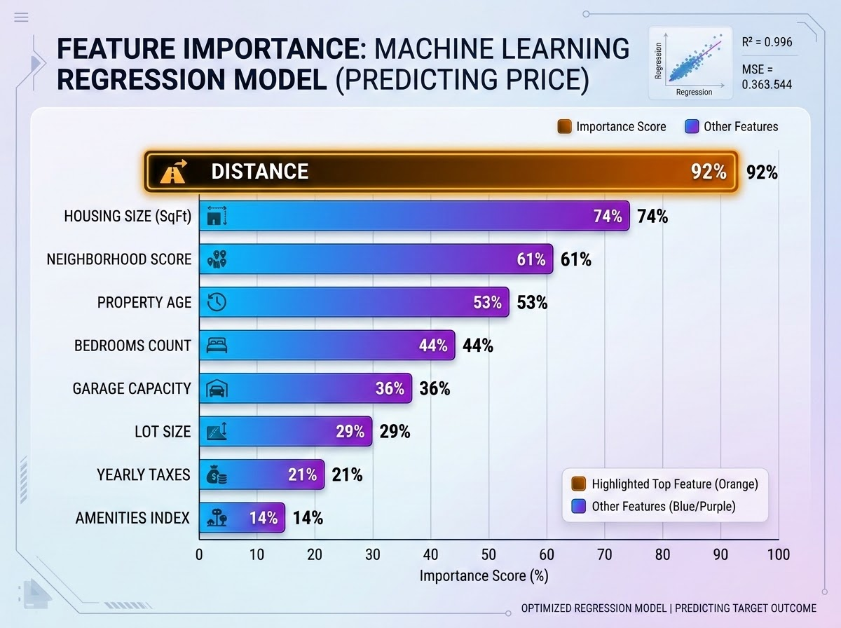
Understanding Delivery Time Factors
OI
UBER EATS
Dominant Predictor
0.797
Distance is the primary driver of delivery time. Weather and traffic were also factored into the regression analysis.
Predictive Power Limitation
A near-zero R² indicates that the model currently explains minimal variance in delivery duration.
Business Action
• Rely on distance for baseline route & delivery planning.
• Collect richer additional features to enhance future predictive accuracy.

Slide 11
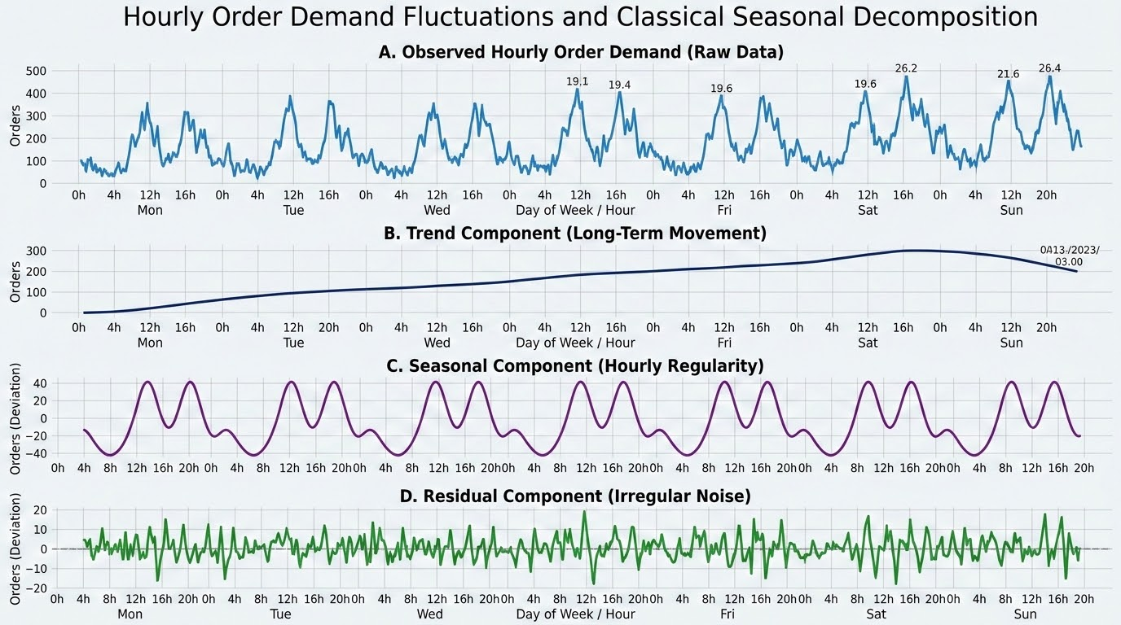
Hourly Demand Forecasting
OI
UBER EATS
To support operational capacity planning, we model hourly order patterns using time-series analysis.
METHODOLOGY & WORKFLOW
Hourly Aggregation: Process begins with hourly aggregation of raw order data.
Time-Series Decomposition: Isolate underlying trend, seasonality, and residual components.
Stationarity Testing: Conduct stationarity testing using the ADF test.
Model Evaluation: Forecast future demand by comparing ARIMA, Prophet, and a Naive Baseline model.
DECOMPOSITION BREAKDOWN
Decomposing raw hourly order demand reveals recurring hourly seasonality peaks and long-term trend lines, isolating irregular noise for reliable operational forecasting models.

Slide 12
Forecast Evaluation and Demand Insights
OI
UBER EATS
PEAK HOUR
TEST MAE
TEST RMSE
02:00
0.34
0.67
0.40 orders/hour
Naive Baseline best
Naive Baseline best
Demand Profile: Demand metrics show an average of 0.34 orders per hour. The peak hour is 02:00 (0.40 orders/hour), while the quietest is 06:00 (0.28 orders/hour).
Model Performance: The Naive Baseline model performed best, achieving a Test MAE of 0.34 and a Test RMSE of 0.67.
Metric Limitation: The Test MAPE was 100%, which reflects the limitations of percentage-based metrics when applied to low-volume, integer-count data.

Slide 13
Translating Machine Learning Results into Business Decisions
OI
UBER EATS
TARGETED ENGAGEMENT & ROUTE PLANNING
HIGH-DEMAND OPERATIONAL READINESS
Segmentation & Support: Segmentation enables targeted customer engagement and tailored restaurant performance support.
Sentiment & Predictions: Sentiment and delivery predictions prioritize overall customer experience (CX) and optimize route distance planning.
Historical demand trends require targeted operational readiness during critical early-morning peak hours:
BENGALURU
02:00 HRS
40 orders
Peak historical volume requires pre-allocated courier capacity.
AVERAGE TIP BY PAYMENT METHOD
Wallet
102.51
DELHI
Cash
99.45
02:00 HRS
34 orders
Card
99.00
07:00 HRS
34 orders
UPI
97.80
Dual-peak demand window requiring staggered operational shifts.
Tip analysis reveals Wallet transactions yield the highest average tip.

Slide 14
Project Limitations and Future Improvements
OI
UBER EATS
CURRENT LIMITATIONS
FUTURE SCOPE & ROADMAP
Clustering Sensitivity: Clusters show high sensitivity to scaling parameters.
Validation Needs: Requires independent dataset validation for accurate sentiment scoring.
Poor Delivery Model Fit: Delivery model exhibits an R² value near zero.
Baseline Outperformance: Naive baseline outperformed complex models with 100% MAPE.
Non-Causal Analysis: Current tip analysis remains strictly non-causal.
Richer Behavioral Data: Incorporate detailed user behavioral and restaurant-level metrics.
External Delivery Features: Integrate real-time external variables such as driver availability.
Extended Historical Data: Expand time-series history for improved trend analysis.
Fine-Grained Tracking: Deploy granular spatial and location tracking capabilities.

Slide 15
End-to-End ML Pipeline – Project Summary
OI
UBER EATS
DAY 01
DAYS 02–06
EVALUATION
DAY 07
Data Generation
Raw data cleaning & feature engineering foundation established.
Pipeline Execution
Segmentation, NLP, Delivery Prediction, and Time Series modeling.
Model & Insights
ML model evaluation translating algorithms into operational business value.
Final Presentation
Synthesized findings delivered to inform operations.
The 7-day project successfully demonstrates an end-to-end framework combining data analytics and ML for food delivery operations.
The pipeline successfully moved from raw data cleaning and feature engineering to ML model evaluation and business insights, proving that integrated analytics can effectively inform and optimize food delivery operations.
Thank You!

